Slide 1
Ant-Man and the Wasp “Quantum” Project
Lt Aaron Giddings

Slide 2
Purpose
What I am Doing: Understanding the plot role that the quantum realm plays in the Marvel Cinematic Universe (MCU)
Why: I was very invested in the MCU and am curious to see the direction it goes.

Slide 3
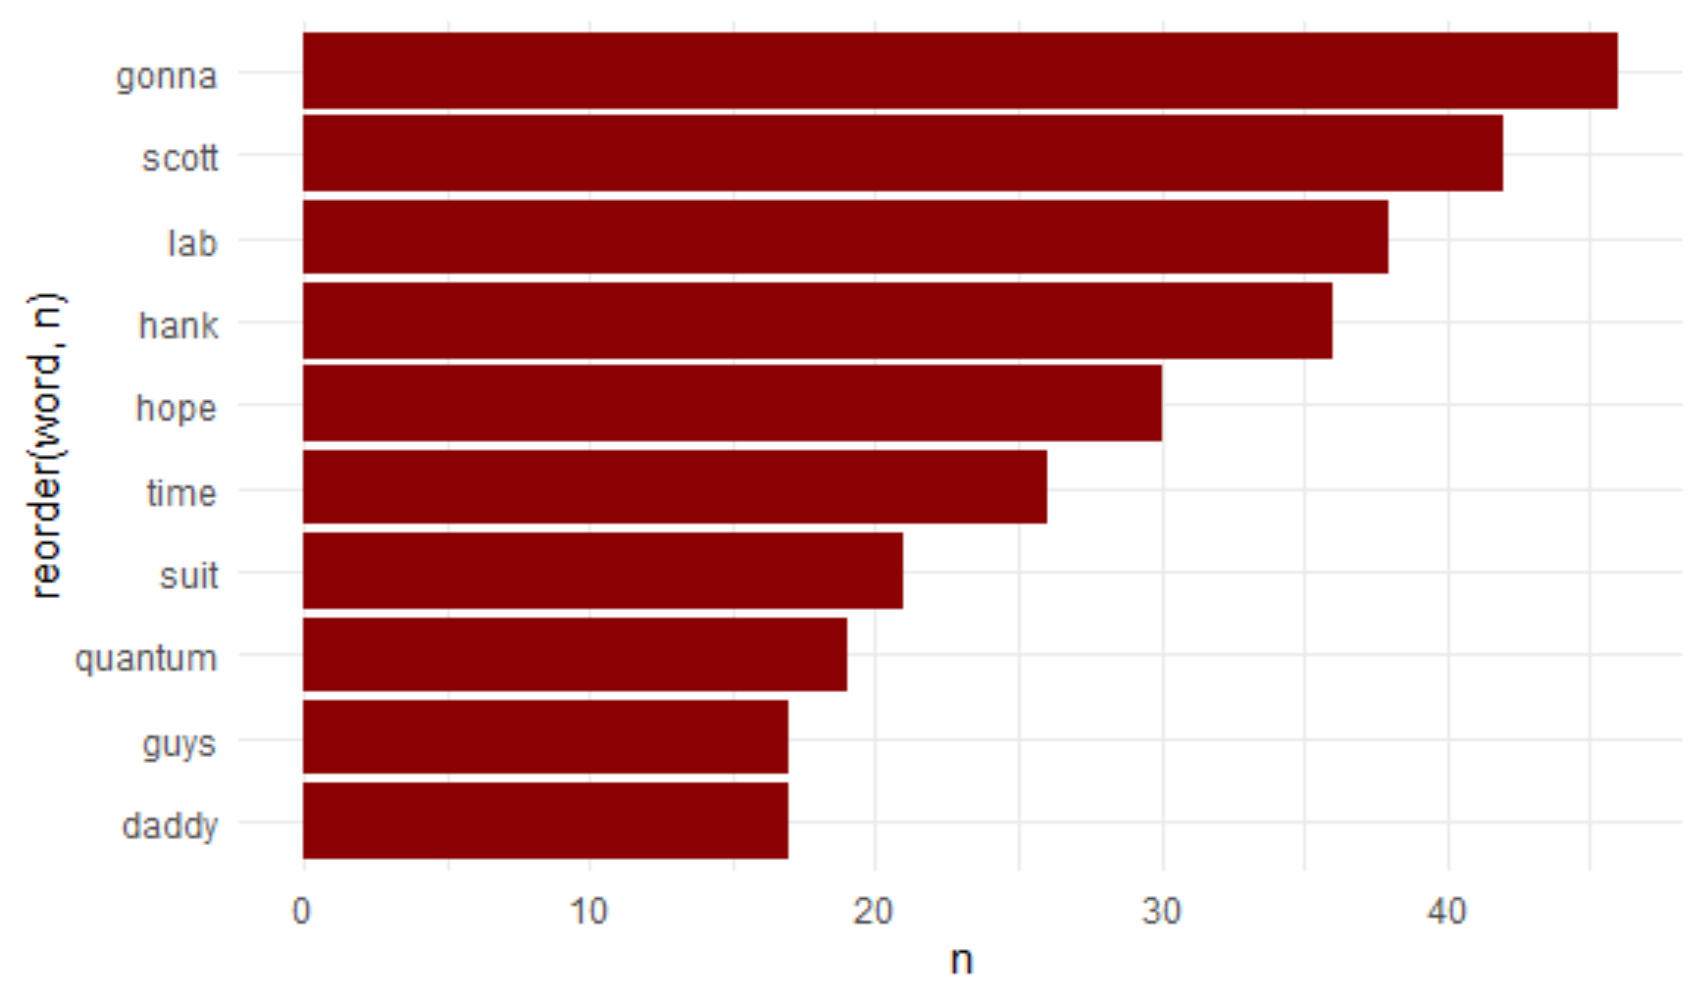
Background
Frequency:
By total number of entries
Summary: After adding a few words to the stop words such as “yeah” and “hey” in addition to the script page counts, “quantum” appears in this script the eighth most frequently with 19 times mentioned.

Slide 4
Background
Based on the raw frequency of the words appearing, 3/10 are character names which can infer that they are important to the plot of the movie.
The appearance of “lab”, “time”, “suit”, and “quantum” implies that these were important items or themes to advance the plot of the movie.
With words like “guys” and “daddy”, those imply a group and family dynamic to the film.

Slide 5
Discuss Next Steps
I want to add the rest of the MCU movies to analyze trends and themes and attempt to predict future plot points.
I also want to analyze the rest of the MCU movies to understand the importance of the quantum realm or other realms to the future of the MCU.

